Slide 1
Adding the Check Out Button

Slide 2
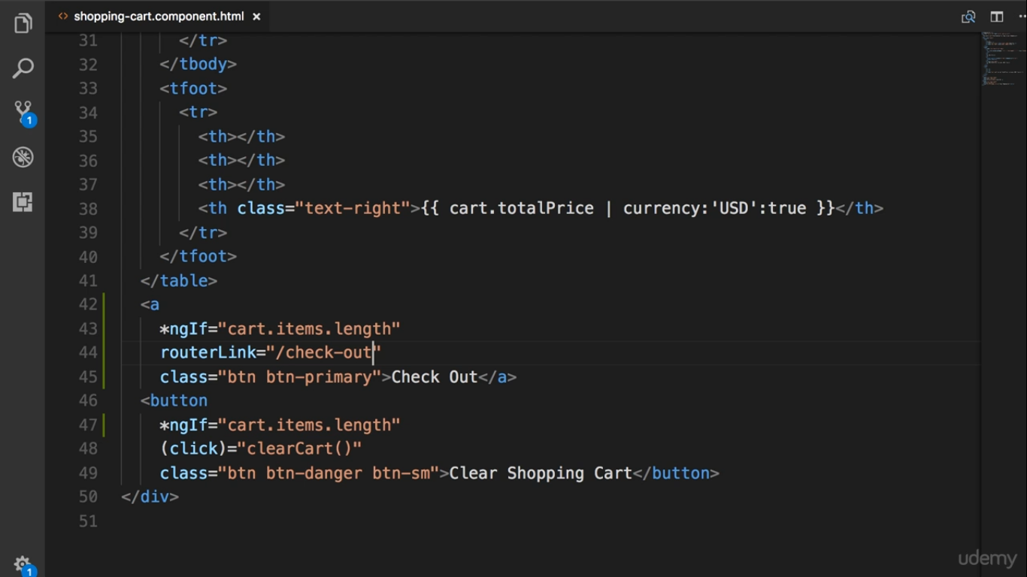

Slide 3
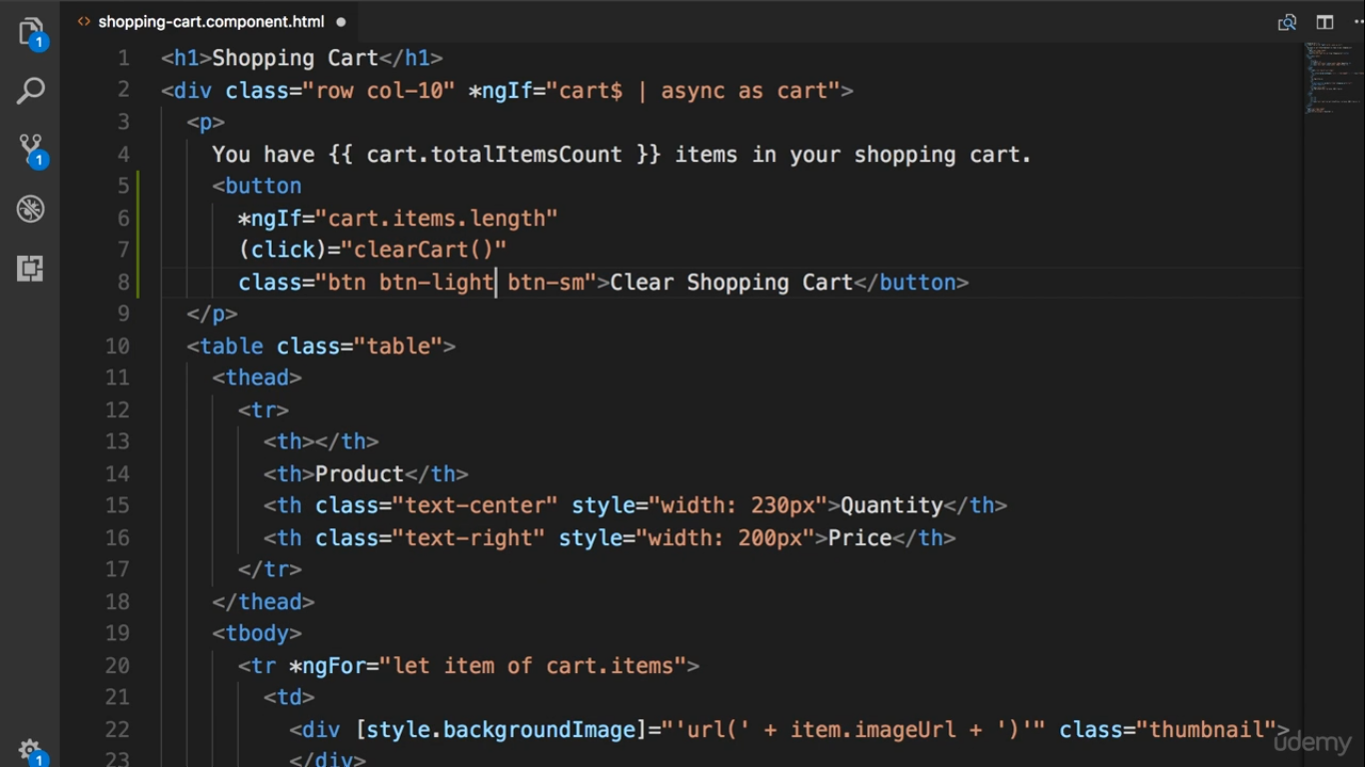

Slide 4
